Slide 1
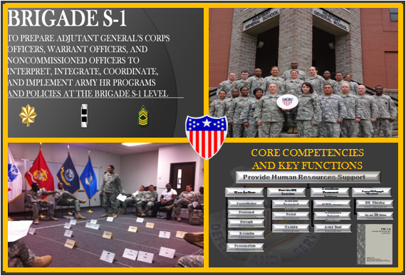
S-1 Operations Course
Senior Leader Training Division
Adjutant General School
Administer Officer Promotions and Selections
February 2015
Notes:
SHOW SLIDE: Administer Officer Promotions and Selections
SECTION I. ADMINISTRATIVE DATA
Academic Hours/Methods
1 hrs/30 mins Small Group Instruction
1 hrs/00 mins Practical Exercise (Performance)
2 hrs/30 mins Total Hours
SECTION II. INTRODUCTION: Today we are going to discuss Officer Promotion
Method of Instruction. Conference/discussion
Instructor to Student Ration: 1:16
Time of Instruction: 5 mins
Media: Small Group Instruction
INSTRUCTIONAL GUIDANCE: Before presenting this lesson, instructors must thoroughly prepare by studying this lesson and identified reference material. Throughout this lesson, solicit from students the challenges they experienced in the current operational environment (OE) and what they did to resolve them. Encourage students to apply at least 1 of the 8 critical variables: political, military, economic, social, information, infrastructure, physical environment and time.
MOTIVATOR. Officer promotions and selections can be a very “sensitive” area. An officer’s selection – or non-selection – will often have far reaching and often immediate impact on not only the affected officer but also his or her family. As the S-1, you must stay current on officer promotion policies and become a subject matter expert on both the decentralized and centralized officer promotion systems.

Slide 2
Terminal Learning Objective
Action: Administer Officer Promotions and Selections
Conditions: Given classroom instruction, AR 350-100 (Officer Active Duty Service Obligations), AR 600-8-29 (Officer Promotions) and awareness of Operational Environment (OE), variables and actors.
Standard: Score 70% or higher on a knowledge based exam that includes the following learning activities:
Define the objectives of the AC officer promotion system.
Communicate decentralized and centralized officer promotion system policies and procedures.
Review DA Selection Board process
Notes:
SHOW SLIDE: TERMINAL LEARNING OBJECTIVE
NOTE: Review the Terminal Learning Objective.
NOTE: This class is based on regulatory guidance from AR 600-8-29, dated 25 Feb 05, effective 25 Mar 05. This version of the regulation was a rapid action revision (RAR) which became effective 25 Feb 05; therefore, briefly review the Summary of Change in AR 600-8-29 with students.
NOTE: The instructor should also be familiar with the promotions module in eMILPO, the eMILPO functional guidance, and the HRC officer selections and promotions website:
https://www.hrc.army.mil/site/Active/select/OfWoProm.htm#acpi
SAFETY REQUIREMENTS. In a training environment, leaders must perform a risk assessment in accordance with DA PAM 385-30, Risk Management. Leaders will complete a DD Form 2977 Deliberate Risk Assessment Worksheet during the planning and completion of each task and sub-task by assessing mission, enemy, terrain and weather, troops and support available-time available and civil considerations, (METT-TC). Local policies and procedures must be followed during times of increased heat category in order to avoid heat related injury. Consider the work/rest cycles and water replacement guidelines IAW TRADOC Regulation 350-29.Note: During MOPP training, leaders must ensure personnel are monitored for potential heat injury. Local policies and procedures must be followed during times of increased heat category in order to avoid heat related injury. Consider the MOPP work/rest cycles and water replacement guidelines IAW FM 3-11.4, Multiservice Tactics, Techniques, and Procedures for Nuclear, Biological, and Chemical (NBC) Protection, FM 3-11.5, Multiservice Tactics, Techniques, and Procedures for Chemical, Biological, Radiological, and Nuclear Decontamination.
RISK ASSESSMENT LEVEL. Low.
ENVIRONMENTAL STATEMENT. Environmental protection is not just the law but the right thing to do. It is a continual process and starts with deliberate planning. Always be alert to ways to protect our environment during training and missions. In doing so, you will contribute to the sustainment of our training resources while protecting people and the environment from harmful effects. Refer to FM 3-34.5 Environmental Considerations and GTA 05-08-002 ENVIRONMENTAL-RELATED RISK ASSESSMENT.
EVALUATION: You will be evaluated on the Brigade S-1 final exam.
INSTRUCTIONAL LEAD-IN. Promotion of personnel is essential in the life of our Army. The Army needs and will continue to need officers to fill its ranks, but also a system by which to promote these officers to various jobs and levels of responsibility. The officer promotion system exists to ensure sufficient personnel exist at various ranks to meet the needs of the Army. Ideally these officers represent the best available.

Slide 3
Outline
Objectives of the Officer Promotion System
Officer Promotion Policies
  Eligibility
  Non-selects
  Selective Continuation
Officer Promotion Systems
  Decentralized
    Presidential Appointment
  Centralized
Responsibilities of the Battalion and Brigade S-1
Notes:
SHOW SLIDE: OUTLINE
Objectives of the Officer Promotion System
Officer Promotion Policies
Eligibility
Non-selects
Selective Continuation
Officer Promotion Systems
Decentralized
Presidential Appointment
Centralized
Responsibilities of the Battalion and Brigade S-1
NOTE: The practical exercise during the course deals mainly with the Active Component (AC) Officer Promotion System.

Slide 4
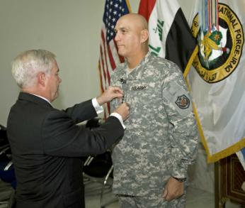
Objectives
Officer Promotion System
Fill authorized spaces with best qualified officers
Provide career progression
Preclude promotion of ineligible
Provide an equitable system
Para 1-1, AR 600-8-29
Notes:
Learning Step/Activity 1. Define the objectives of the AC officer promotion system.
Method of Instruction: Conference/Discussion
Instructor to Student Ratio: 1:16
Time of Instruction: 5 mins
SHOW SLIDE: OFFICER PROMOTION SYSTEM OBJECTIVES
NOTE: Refer students to AR 600-8-29, Para 1-1.
The primary objectives of the Officer Promotion Management System (OPMS) are:
(1) Filling authorized spaces with best qualified officers.
(2) Provides career progression based on recognition of an officer’s potential to serve in positions of increased responsibility.
(3) Precludes promoting the officer who is not eligible or becomes disqualified thus providing an equitable system.
The laws and regulations that govern officer promotions are:
(1) AR 600-8-29
(2) DOPMA - Defense Officer Personnel Management Act
(3) WOMA - Warrant Officer Management Act
(4) Title 10, United States Code
NOTE: Refer students to the summary at the beginning of AR 600-8-29, Page i.

Slide 5





Officer Promotion Systems
Decentralized selection process
  GEN (Presidential Appointment)
  LTG (Presidential Appointment)
  1LT (Battalion Commander)
  CW2 (Battalion Commander)
Centralized selection process
  MG, BG, COL, LTC, MAJ, and CPT will be IAW sections 611 through 626 and 628, Title 10, United States Code (USC)
  CW5, CW4, and CW3 will be IAW sections 571 through 583, Title 10, USC
Para 1-7 & 1-9, AR 600-8-29
Notes:
SHOW SLIDE: OFFICER PROMOTION SYSTEMS
Learning Step/Activity 2. Communicate decentralized and centralized officer promotion system policies and procedures.
Method of Instruction: Conference/Discussion
Instructor to Student Ratio: 1:16
Time of Instruction: 40 mins
NOTE: Refer students to AR 600-8-29, Para 1-7 and 1-9.
There are three promotion systems that exist for officers in the Army – Decentralized, Presidential Appointment and Centralized.
The Army has a decentralized promotion system for the following grades:
GEN (promotion authority = Presidential Appointment)
LTG (promotion authority = Presidential Appointment)
1LT (promotion authority = LTC commander)
CW2 (promotion authority = LTC commander)
(Para 1-7, AR 600-8-29)
All other grades are covered by a centralized system of promotion, which means the promotion selection board is convened by DA. Selection for and promotion to the grades of MG, BG, COL, LTC, MAJ, and CPT will be according to sections 611 through 626 and 628, Title 10, USC. Selection for and promotion of (CWOs to the grades of CW5, CW4, and CW3 will be according to sections 571 through 583, Title 10, United States Code. (Para 1-9, AR 600-8-29)

Slide 6
Promotion Eligibility
Requirements
Current Grade | Time in Grade (TIG) for Promotion “Consideration” | Time in Grade for Promotion
WO1* | No Requirement | 2 Years
CW2 – CW4 | 2 Years Active | No Additional Requirement
2LT | No Requirement | 18 Months
1LT | No Requirement | 2 Years
CPT – LTC | 3 Years | No Additional Requirement
COL – BG | 1 Year | No Additional Requirement
* WO1s must serve 18 months on active duty before promotion to CW2.
Para 1-10c, AR 600-8-29
Notes:
SHOW SLIDE: PROMOTION ELIGIBILITY REQUIREMENTS
NOTE: Refer students to Paragraph 1-10c, AR 600-8-29 for all rules and requirements concerning promotion consideration and promotion.
As established by the Secretary of the Army (SA), officers must meet the following minimum Time in Grade (TIG) requirements to be considered for promotion:
(1) WO1. There are no minimum TIG requirements for officers to be considered for promotion to CW2; however, they must have at least 2 years TIG including service credit, if applicable, to be promoted. Furthermore, WO must serve 18 months on active duty in the grade of WO1 before promotion to CW2.
(2) CW2, CW3, and CW4. These officers may not be considered for promotion to the next higher grade until they have completed 2 years of active duty in their current grade.
(3) 2LT and 1LT. The law establishes no minimum TIG requirements for consideration for promotion; however, an officer must have at least 18 months TIG to be promoted to 1LT and 2 years TIG to be promoted to CPT. The TIG requirement for promotion to 1LT has been extended to 2 years by the authority of the SA.
(4) CPT, MAJ, and LTC. These officers must serve at least 3 years TIG to be considered for promotion. This requirement may be waived by the SA, for consideration from below the zone.
(5) COL and BG. Officers must serve 1 year TIG to be considered for promotion. If selected, they may be promoted without regard to any additional TIG requirements.
NOTE: Explain to students that the rules can change based on guidance from HRC.

Slide 7
AC FY12/13 Promotion Rates
Officer Promotion Rates |  |  |  |  |  | Warrant Officer Promotion Rates
Rank | Current Promotion Rate | Projected Promotion Rate | Current Pin on point (YRS) | Projected Pin on point (YRS) |  | Rank | Current Promotion Rate (AV / Tech) | Current Pin on Point (YRS)
CPT | 92.50% | 90% | 3.5 | 4 |  | CW2 | 98.1 / 97.3% | 2
MAJ | 83.50% | 80% | 9.8 | 10.5 |  | CW3 | 58.4 / 74.5% | 6
LTC | 83.00% | 70% | 16.7 | 17 |  | CW4 | 60.6 / 80.6% | 14
COL | 37.20% | 50% | 21.8 | 22.5 |  | CW5 | 21.0 / 26.1% | 20
Future Promotion Opportunity targeted to future requirements
Expect increase in time in grade to CPT, MAJ and COL
Notes:
This data comes from MAJ Gillespie TAGD promotions

Slide 8
Unmasking of Army Officer Evaluations Reports
(Army Directive 2015-07)
Elimination of the masking process supports transparency
Improves the accuracy of an officer’s file in personnel management decision for the individual officer and the Army
  Boards are now best qualified vs. fully qualified – ensures we retain and promote best
All OERs, including previously masked OER will be placed in the performance section of the official Army Military Human Resource Records file.
Notes:
As we move from fully qualified to best qualified selection boards

Slide 9
Not Eligible for Promotion
Officers are not eligible for promotion if:
  Separation or retirement date falls within 90 days of the board convened date
  1LTs twice not selected for promotion to CPT
  WOs twice not selected for promotion to CW3, CW4, or CW5 and not selectively continued
  WOs with less than 3 years of active duty service in their current grade
  Commissioned officers with less than 1 year of continuous active duty
Para 1-10e, AR 600-8-29
Notes:
SHOW SLIDE: NOT ELIGIBLE FOR PROMOTION
NOTE: Refer students to Paragraph 1-10e, AR 600-8-29 for all rules concerning officers not eligible for promotion.
Officers in the following categories are not eligible for consideration by a promotion selection board:
(1) Officers whose established separation or retirement date falls within 90 days after the date on which the board is convened (10 USC 577 and 619).
(2) 1LTs twice not selected for promotion to CPT.
(3) Warrant officers (WOs) twice not selected for promotion to CW3, CW4, or CW5 and not selectively continued.
(4) Chief Warrant Officers with less than 3 years of active duty service in their current grade (10 USC 574).
(5) Commissioned officers with less than 1 year of continuous active duty (since their most recent placement on the ADL) before the board convenes.

Slide 10
Non-Select for Promotion to 1LT and CW2
To 1LT
  6 month evaluation period if a potential for promotion exists
  Separate within 90 days if performance determined inconsistent with good order and discipline
To CW2
  Separate within 90 days
Exceptions
  Revert to enlisted rank if statutory requirement exists
  If 2 years from retirement
Requirements
  Process a DA Form 78 on all non-selects NLT the Promotion Eligibility Date (PED)
Para 1-13 & Para 3-5, AR 600-8-29
Notes:
Learning Step/Activity 2. Communicate decentralized promotion system policies and procedures.
Method of Instruction: Conference/Discussion
Instructor to Student Ratio: 1:16
Time of Instruction: 25 mins
SHOW SLIDE: NON-SELECT FOR PROMOTION TO 1LT AND CW2
NOTE: Refer students to AR 600-8-29, Para 1-13 and 3-5.
If officers are not selected for promotion to 1LT or CW2, the following rules apply:
(1) A 2LT will be retained for evaluation for 6 months providing retention is in accordance with “good order and discipline.” If after 6 months the officer is not deemed qualified for promotion, then he/she will be notified of pending separation and will be separated within 90 days of notification. During the 6 month period, if the officer is found fully qualified for promotion then the promotion will be effective the date the officer is found fully qualified.
(2) If a WO1 is non-selected for promotion then they must be separated from active duty within 90 days of notification of non-selection. Exception to this action is if the officer is within two years of retirement under the provisions of Chapter 3, AR 635-100 and is eligible for a REFRAD (Release From Active Duty).
(3) If any officer is a non-select for promotion to 1LT or CW2, a DA Form 78 must be completed by the Promotion Work Center and forwarded to the Battalion S-1 who procures the appropriate signatures from the recommending authority, approval authority, and promotion review authority (PRA).

Slide 11
Twice Non-Select for Promotion
to CW3-CW5 and CPT-LTC
Discharged or REFRAD IAW AR 600–8–24
Retired under any provision of law, if eligible
Retained on active duty until qualified for retirement if within 2 years of qualifying for retirement
Selectively continued under provisions of Para 1–14,
AR 600-8-29
AMEDD officers – recommended for continuation on active duty until all active duty service obligations have been fulfilled
Notes:
SHOW SLIDE: TWICE NON-SELECT FOR PROMOTION TO CW3-CW5 AND CPT-LTC
NOTE: Refer students to AR 600-8-29, Para 1-13.
If officers are not selected for promotion to CW3-CW5 and CPT-LTC, the following rules apply:
(1) Discharged or released from active duty according to AR 600–8–24.
(2) Retired under any provision of law, if eligible, on the date requested by the officer and approved by proper authority (retirement will be not later than the first day of the seventh month beginning after the month in which the President or the President’s designee approves the report of the board that considered the officer the second time).
(3) Retained on active duty (if a commissioned officer) until qualified for retirement if, on the date the officer would otherwise have been discharged, he or she is within 2 years of qualifying for retirement under 10 USC 1293, 3911.
(4) Retained on active duty (if a warrant officer) until qualified for retirement if he or she is within 2 years of qualifying for retirement on the date the SA approves the board report.
(5) Selectively continued under provisions of paragraph 1–14.
(6) In the case of fully qualified AMEDD officers, recommended for continuation on active duty by a selective continuation board until all active duty service obligations have been fulfilled as prescribed in paragraph 1–14, AR 600-8-29.

Slide 12
Selective Continuation
Allows continued service if not promoted in primary or above-the-zone categories
Selective Continuation Board recommends officers for continued service – SA approves list
Officers cannot apply for selective continuation
Applies to promotions to:
  CW3, CW4, or CW5
  MAJ or LTC
Para 1-14, AR 600-8-29
Notes:
SHOW SLIDE: SELECTIVE CONTINUATION
Selective continuation is driven by the determined “needs of the Army.” Officers not selected during their primary or above the zone promotion considerations to CW3, CW4, CS5, MAJ or LTC may be selectively continued on active duty in their present grade. This action is not something for which an officer can apply.
Officers under consideration for selective continuation will receive notice from DA regarding their status. At that time DA will provide the officer with their options regarding continued service. The officer’s response is forwarded back to DA for resolution.

Slide 13
Check on Learning
Q: What are the three officer promotion systems?
A: Decentralized, Presidential Appointment to LTG and GEN, and Centralized.
Q: True or false, 2LTs must be immediately separated within 90 days if they are not promoted to 1LT?
A: False, a 2LT can be given a 6 month evaluation period if a potential for promotion exists.
Q: True or False, officers can apply for selective continuation.
A: False, DA will determine officer selective continuation.
Notes:
SHOW SLIDE: CHECK ON LEARNING
NOTE: Conduct a check on learning and summarize the learning activity.

Slide 14


Decentralized Promotion
System Key Components
Determining Active Date of Rank (ADOR)
Compute Promotion Eligibility Date (PED)
Promotion Authorities
Automated Promotion Management
Notes:
SHOW SLIDE: DECENTRALIZED PROMOTION SYSTEM KEY COMPONENTS
The decentralized promotion system applies primarily for 1LT and CW2 promotions. Decentralized promotions to GEN and LTG are not Brigade S1 functions, are executed by DA through Presidential Appointment, and will not be taught during this block of instruction.
The key components of the decentralized promotion system are:
Determining Active Date of Rank (ADOR)
Compute Promotion Eligibility Date (PED)
Promotion Authorities
Non-Selection Rules / DA Form 78
Promotion Eligibility Factors
Promotion Management

Slide 15
Determining 2LT / WO1
Active Date of Rank (ADOR)
2LT ADOR for USMA graduates will be the date of their appointments as RA 2LTs
2LT ADOR of graduates of a service academy other than USMA will be the USMA main graduation date in the year of their appointment (see HRC instructions for details)
2LT ADOR of ROTC cadets in May or June of any year is the same as the USMA main graduation date for that year
ADOR of an officer receiving an original appointment as an RA commissioned officer, other than as stated above, is the date the appointment is accepted
For an OTRA ROTC 2LT, see para 2-1f thru 2-1i, AR 600-8-29
WO1 ADOR – See Table 2-1, AR 600-8-29
Para 2-1 and Table 2-1, AR 600-8-29
Notes:
SHOW SLIDE: DETERMINING 2LT ACTIVE DATE OF RANK (ADOR)
NOTE: Refer students to AR 600-8-29, Para 2-1.
Reference Para 2–1. Rules for determining active date of rank for 2LTs and WO1s being placed on the active duty list.
(1) The 2LT ADOR for USMA graduates will be the date of their appointments as RA 2LTs. The 2LT ADOR of graduates of a service academy other than USMA, who graduate on the main graduation date of their service academy and are appointed as 2LT RA under 10 USC 541(b), will be the USMA main graduation date in the year of their appointment. See HRC instructions for details.
(2) The 2LT ADOR of Reserve Officer Training Corps (ROTC) cadets appointed as RA 2LTs under 10 USC 2106 or 2107 in May or June of any year is the same as the USMA main graduation date for that year. (Eligibility for promotion on the ADL from 2LT to 1LT is based on PED rather than 2LT ADOR. See Chapter 3 for further guidance.)
(3) The ADOR of an officer receiving an original appointment as an RA commissioned officer, other than as stated above, is the date the appointment is accepted unless the appointee was, at the time of appointment, a Reserve officer or received entry grade credit under 10 USC 533 (including regular officers of another branch of service). The ADOR of these officers is determined according to paragraph 1D38 of AR 600-8-29.
(4) The CG, Army Human Resources Command, notifies the field of periods of reserve commissioned service not in an active status for all 2LTs placed on the ADL. Unless notified by Army Human Resources Command that a 2LT has a period of reserve commissioned service in an inactive status, the field will assume all reserve service as a 2LT is in an active status.
(5) For an OTRA ROTC 2LT, see para 2-1f thru 2-1i, AR 600-8-29.

Slide 16
Compute Promotion Eligibility Date
(PED) to 1LT / CW2
AR 600-8-29, Chapter 3 covers promotion eligibility date determination for promotion to 1LT and CW2
Table 3–2 covers computing PED to 1LT
Table 3–3 covers computing PED to CW2
Notes:
SHOW SLIDE: COMPUTE PROMOTION ELIGIBILITY DATE (PED) TO 1LT / CW2
NOTE: Refer students to AR 600-8-29, Chapter 3.
AR 600-8-29, Chapter 3 covers in detail promotion eligibility date determination for promotion to 1LT and CW2.
(1) Table 3–2 covers computing PED to 1LT.
(2) Table 3–3 covers computing PED to CW2.

Slide 17
1LT / CW2
Promotion Authorities
Recommending Authority (officer’s rater)
Approval Authority
  Must be LTC or frocked MAJ(P) in command position
  Normally Senior Rater (Battalion Commander)
Promotion Review Authority (PRA)
  Takes final action on 2LT / WO1 not recommended for promotion
  Commander having General Court Martial Authority (GCMCA)
  or
  1st General Officer (GO) in chain of command with a Judge Advocate available.
  PRA decision is final
Para 1-16, AR 600-8-29
Para 3-5, AR 600-8-29
Notes:
SHOW SLIDE: 1LT / CW2 PROMOTION AUTHORITIES
NOTE: Refer students to AR 600-8-29, Para 1-16.
The following are the decentralized officer promotion authorities:
(1) The Recommending Authority is the eligible officer’s rater. This officer makes the initial recommendation on whether or not an officer should be promoted.
(2) The Approval Authority is normally the eligible officer’s LTC commander, but does not have to be. It may be the same person as the recommending authority, provided the officer is a commander who is at least a LTC or frocked MAJ(P).
NOTE: Explain to the students that an officer is frocked when they are promotable and serving in a position that merits the higher grade (example: Battalion Commander). The frocking must be approved by Department of the Army (DA).
(3) The approval authority approves or disapproves the recommending officer’s recommendation, and in doing so approves the eligible officer’s promotion.
NOTE: Refer the students to AR 600-8-29, Para 3-5.
(4) The Promotion Review Authority (PRA) takes the final action in all cases in which the approval authority recommends against promotion. The decision of the PRA is final. The PRA is one of the following:
(a) The commander having general court-martial convening authority (GCMCA).
(b) The first Army general officer in the chain of command that has a Judge Advocate available.

Slide 18
Automated Promotion Management
(1 of 2)
Promotions via web-based application on eMILPO
Direct access for promotion authorities and authorized representatives (normally S-1 Section personnel)
View eligible officers 2 months prior to PED using eMILPO
Must have an AKO account to access promotions application
System must be updated NLT 20th of each month
Promotion is automatic unless actively precluded by Chain of Command
Notes:
SHOW SLIDE: AUTOMATED PROMOTION MANAGEMENT (1 OF 2)
Decentralized promotions are managed through eMILPO. The promotion approval authorities must have an Army Knowledge Online (AKO) account to access the promotion application. The application allows direct access for promotion authorities and authorized users to recommend and approve officers for promotion to 1LT and CW2. Effective Jan 04, promotions to 1LT and CW2 are automatic unless commanders actively preclude the promotion from happening. The system must be updated by the 20th of each month in order for promotions to be effective on time.
The promotion approval authority can designate the S1 or HRC Officer or Warrant Officer to conduct promotion to 1LT / CW2 on their behalf. This will most likely be the case as most commanders have too much on their plates to be logging to AKO to do monthly promotions.

Slide 19
Automated Promotion Management
(2 of 2)
Automatic updates include:
  TAPDB and DFAS
  Generates a promotion order
    Sent directly to officer’s OMPF
    Retrievable thru TOPMIS II
Flagged officers (per AR 600-8-2):
  Identified on web application
  Automatically disapproved for promotion
Eligible for promotion after lifting flag in eMILPO and processing update thru TAPDB
Hard copy DA Form 78s only required for non-selects
Notes:
SHOW SLIDE: AUTOMATED PROMOTION MANAGEMENT (2 OF 2)
The eMILPO promotion system will automatically update information in the officer’s record and has the following embedded capabilities:
(1) It will automatically update the Total Army Personnel Data Base (TAPDB) and the Defense Finance Accounting System (DFAS), generate a promotion order which will be available via TOPMIS II, and the order will be sent directly to the officers OMPF.
(2) Flagged officers will be identified on the web application and will automatically be disapproved for promotion; therefore it is imperative that the promotion authority or authorized representative review promotion recommendations in the system monthly.
(3) Once a flag is lifted the officer will again be eligible for promotion within the system.
(4) The system eliminates almost all paperwork. A hard copy of DA Form 78s only need to be filled out when an officer is not selected for promotion. The DA Form 78 must be kept on file until the situation is resolved (officer promoted or released from active duty).

Slide 20
Scenario
The Brigade Commander sends you an email requesting information regarding his junior officers. Specifically, he wants to know who all the WO1/2LT and 1LT/CPTs in the brigade are with a date of rank beginning in January 2009. He wants a roster by Last Name, First Name, Rank, Unit, DOR, and BASD. The Commander also wants the roster sorted by Rank.
Today is 18 March 2011.
How many WO1/2LT and 1LT/CPTs are in the Brigade?
Notes:
SHOW SLIDE: SCENARIO
Note to Instructor: For assistance with this scenario, open the Employ Electronic Military Personnel Office (eMILPO) class.
How many WO1/2LT and 1LT/CPTs are there in the Brigade?
Answer
WO1 = 3
2LT = 2
1LT = 1
CPT = 21

Slide 21
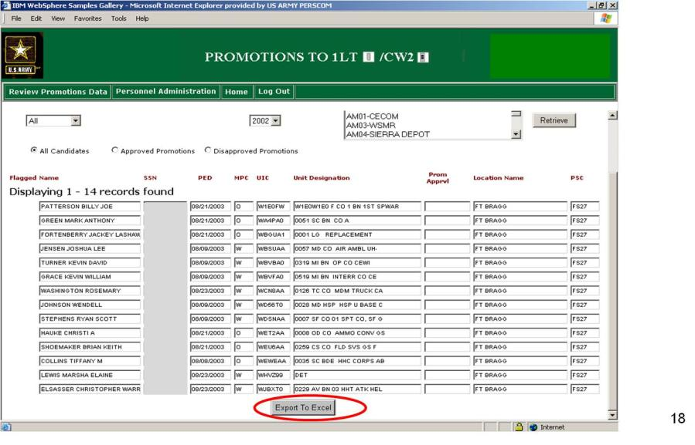
BDE S-1 Review
Notes:
SHOW SLIDE: BDE S-1 REVIEW
NOTE: Explain to students that this slide is a screen shot from eMILPO demonstrating what the BDE S1 can review.
In the past, Personnel Services Battalions (PSBs) could do a PSB Review which showed them every Unit Identification Code (UIC) for units in their area of responsibility. This allowed the PSB to know which Battalion’s had completed their officer promotion reviews on eMILPO. Under Personnel Services Delivery Redesign (PSDR), this responsibility now belongs to the BDE S1. The BDE S1 is able to view all subordinate UICs to see if all Battalions have completed their officer promotion review or not.
Once the list is displayed, it can be exported to Microsoft Excel in order to be sorted and for ease of use at BDE level.

Slide 22
Check on Learning
Q: What date starts the clock and eventually determines a 2LT’s or WO1’s promotion eligibility date to the next higher grade?
A: Active Date of Rank (ADOR).
Q: True or false, all 2LT and WO1 ADORs are the same for every class year?
A: False, 2LT and WO1 ADORs can be different. Para 2-1 and Table 2-1,
AR 600-8-29 provide specific guidance.
Q: Where can an S1 find guidance to determine a 2LT’s or WO1’s promotion eligibility date (PED) to the next higher grade?
A: Chapter 3, AR 600-8-29. Table 3–2 covers computing PED to 1LT. Table
3–3 covers computing PED to CW2.
Notes:
SHOW SLIDE: CHECK ON LEARNING
NOTE: Conduct a check on learning and summarize the learning activity.

Slide 23




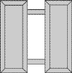


Centralized Promotion
System Key Components
Centralized Promotion System
Promotion Eligibility
Approval Authorities
Promotion Zones
Order of Promotion
Promotion Acceptance
Promotion Ceremonies
Frocking Criteria
Critically or Terminally ILL
Posthumous Promotions
Special Branch Promotions
Notes:
Learning Step/Activity 3. Communicate Centralized promotion system policies and procedures.
Method of Instruction: Conference/Discussion
Instructor to Student Ratio: 1:16
Time of Instruction: 25 mins
SHOW SLIDE: CENTRALIZED PROMOTION SYSTEM KEY COMPONENTS
The key components of the centralized officer promotions system are:
(1) Centralized Promotion System
(2) Promotion Eligibility
(3) Approval Authorities
(4) Promotion Zones
(5) Order of Promotion
(6) Promotion Acceptance
(7) Promotion Ceremonies
(8) Frocking Criteria
(9) Critically or Terminally ILL
(10) Posthumous Promotions
(11) Special Branch Promotions

Slide 24
Centralized Promotion
System
DA Board convenes to determine individuals selected for promotion
  Separate board for each competitive category and grade
  Composed of at least 5 active duty officers
  Senior in grade to those under promotion consideration
  Representation from each category under consideration
Annual schedules published by HRC:
  MILPER Messages
  HRC Web Page
Para 1-30 & 1-31, AR 600-8-29
Notes:
SHOW SLIDE: CENTRALIZED PROMOTION SYSTEM
The centralized system involves the convening of a DA board to determine individuals selected for promotion. The following is the general process for a centralized board:
(1) There is a separate board for each competitive category and grade.
NOTE: Inform students that examples of different boards are Army Competitive, Chaplain, and Medical Service – each have separate boards for each rank.
NOTE: Refer students to AR 600-8-29, Para 1-9c and Para 1-9e.
(a) Boards selecting CPTs thru MGs have a board for each grade and competitive category.
(b) CW3, CW4 & CW5 have a selection promotion board that considered these ranks at the same time.
(2) Boards are composed of at least 5 active duty officers.
(3) Officers sitting on a board must be senior in grade to those under consideration by the board.
(4) Annual schedules for boards are published by Human Resources Command in the form of MILPER Messages and are published online at Human Resources Command.

Slide 25
Centralized Promotion Eligibility
Determined by the Army G-1
Approved by the Secretary of the Army (SECARMY)
Based on:
  Active Date of Rank (ADOR)
  Time in Grade (TIG)
Reference: Para 1-10b
Notes:
SHOW SLIDE : CENTRALIZED PROMOTION ELIGIBILITY
NOTE: Refer students to AR 600-8-29, Para 1-10b.
Eligibility is similar to that of the decentralized system in that it is determined by the Army G1 and approved by the SECARMY. Additionally, from an individual officer’s standpoint, eligibility is based on officer’s ADOR and TIG.

Slide 26
Approval Authority
The President has delegated authority to the Secretary of Defense to approve/disapprove promotion board reports
SECARMY has the authority to approve/disapprove promotion board reports for:
  Warrant Officer promotions
  Selective continuation boards
  Promotion review boards
Senate confirmation required for promotions to MAJ and above
Para 1-11, AR 600-8-29
Notes:
SHOW SLIDE: APPROVAL AUTHORITY
United States law establishes the Army’s promotion authorities. The President of US is the ultimate promotion authority, but has delegated authority to the Secretary of Defense for approval / disapproval of promotion board reports. The SECARMY has authority to approve or disapprove promotion board reports for WOs promotion, all selective continuation, and promotion review boards.
NOTE: Refer students to AR 600-8-29, Para 1-11.
(1) Title 10 of the United States Code, The Defense Officer Personnel Management Act (DOPMA) and the Warrant Officer Management Act (WOMA) are some of the laws that govern officer promotions.
(2) An additional requirement is that the US Senate must confirm all promotions to the grade of MAJ and above according to 10 USC 624(c).

Slide 27
Promotion Zones
“BELOW THE ZONE”
1st Time – Only Selected Officers
Applies to CW4-CW5 and MAJ-COL
“IN THE ZONE”
2d Time – Normal Career Progression
“ABOVE THE ZONE”
3d Time – Last Chance
Para 1-17 and 1-34, AR 600-8-29
Notes:
SHOW SLIDE: PROMOTION ZONES
There are three chances for an officer to be promoted to the next higher rank:
NOTE: Refer students to AR 600-8-29, Para 1-17 and 1-34a and d.
(1) Below the zone promotion – ahead of peers or year group. This pertains to all grades except CPT, BG & MG. (i.e., to MAJ, LTC & COL). Make sure to note that the regulation states that officers are not promoted to CW3 below the zone, however there has been a change to the regulation. The basic idea is that only outstanding officers are selected in this zone. Non-selection for below the zone is normal and not considered detrimental to an officer. As mentioned earlier, the total number of officers selected in this category cannot exceed 10% of the total officers recommended, but the Secretary of Defense may authorize up to 15%.
(2) In the zone promotion – with peers; normal career progression. This is technically your second look, but only the first one that counts. Non-selection during this look is an officer’s first non-select. The next promotion board then reevaluates the officer the following year to obtain promotion in the above-the-zone look.
(3) Above the zone promotion – behind peers; third and last realistic chance. Any officer who fails to be selected for promotion two times will be subject to the provisions listed in Para 1-13a. Officers selected for selective continuation will continue to be considered for promotion until separated.
Promotion zones are determined by DOR, and all fall roughly along year-group lines.
NOTE: Refer students to page 3, Para 1-10c(4).
(b) CPTs, MAJs, and LTCs must serve at least 3 years TIG to be considered for promotion.
(4) After the promotion board adjourns, it normally takes 60 to 90 days of processing and distribution time before the board results are released. The results are released world-wide at a date / time specified by HRC. Until the release date / time, board results must be maintained in a “close hold” status. Once the results are distributed to the promotion work center (Brigade / BCT S1 - approximately 2 weeks before the release date), they must ensure that the officers on the list are still in a promotable status and not flagged.

Slide 28
Order of Promotion
Based on seniority (sequence number)
Upon exhaustion of previous promotion list:
  Above the zones promoted first
  In the zone promoted next
  Below the zone promoted last (still ahead of peers)
Applies to officers and warrant officers
Para 1-17, AR 600-8-29
Notes:
SHOW SLIDE: ORDER OF PROMOTION
NOTE: Refer students to AR 600-8-29, Para 1-17.
Officers selected for promotion by the board will be promoted from the promotion standing list based on their sequence number that is assigned by date of rank and other factors. For United States Military Academy (USMA) officers they even go as far back as class rank to determine sequence number. The number of officers promoted to a given rank in a particular month is a function of force structure and budgetary constraints and is announced by MILPER message monthly.
(1) The sequence numbers are established based on seniority / ADOR. Personnel selected from Above-the-Zone will have the lowest numbers (promoted first), while those selected from Below-the-Zone will have the highest (promoted last).
(2) Each preceding year’s list is expired before anyone is promoted from the following year’s promotion list. Typically, promotion lists run by fiscal year, with the first group of promotions taking place on 1 Oct and the last promotions expiring the list usually occurring on 1 Sep of the following calendar year.
(3) Normally all Above-the-Zone selectees are promoted on 1 Oct and all Below-the-Zone selectees are promoted the following 1 Sep.

Slide 29
Promotion Acceptance
Commissioned Officers
  Incur no service obligation for promotion
  Incur minimum TIG obligation to retire at rank
    GEN / LTG – no TIG; have consent of Senate
    MG, BG, COL, LTC – 3 years
    MAJ, CPT, 1LT – 6 months (AR 350-100, Para 2-5)
  OTRA commissioned officers must accept RA appointment
  upon appointment to MAJ (AR 601-100, Chapter 2)
Warrant Officers
  Appointment to WO1 incurs 6 year obligation
  2 year obligation with promotion to CW3, CW4, and CW5 (AR 350-100, Para 2-5)
  Must accept RA appointment upon promotion to CW3 (AR 601-100, Chapter 2)
Para 1-18, AR 600-8-29
Notes:
SHOW SLIDE: PROMOTION ACCEPTANCE
NOTE: Refer students to AR 600-8-29, Para 1-18; AR 350-100, Para 2-5; and AR 601-100, Chapter 2.
Unless an officer declines a promotion in writing they will be promoted when their sequence number is announced. If an officer decides to decline a promotion, the following actions occur:
(1) Should be counseled by rater regarding impact of declination.
(2) The officer will be deleted from promotion list; 2LT or WO1 who decline promotion are ineligible for subsequent ones. Officers will separate upon expiration of service obligation.
(a) Commissioned officers, regardless of rank, do not incur a service obligation for accepting a promotion. However, to retire at the promoted grade requires completion of successful periods of service respectively:
GEN / LTG – no TIG, but do have to have consent of Senate.
MG, BG, COL, and LTC – 3 years TIG.
MAJ, CPT and 1LT – 6 months TIG.
NOTE: Refer students to AR 350-100, 2-5, and Para 1-18b.
(b) Commissioned Officer, other than Regular Army (OTRA) officers, who decline a Regular Army appointment upon promotion to MAJ will be released from active duty according to AR 601-100 and AR 635-100.
NOTE: Refer students to AR 350-100, Paras 1-18b(1), 2-3, and 2-5.
Warrant Officers incur a 6-year Active Duty Service obligation for accepting a warrant officer appointment. Additionally, when a warrant officer accepts a promotion to CW3, CW4 or CW5, they incur a 2-year service obligation.

Slide 30
Promotion Ceremonies
Conducted on effective date of promotion
May be conducted prior to effective date when:
  Occurs on weekend or national holiday
  Occurs when on leave or enroute to new duty (not TDY)
  Promote last duty day before effective date
  Promote not earlier than 15 days of effective date; should take place on last duty day the officer is present
Para 1-24, AR 600-8-29
Notes:
SHOW SLIDE: PROMOTION CEREMONIES
NOTE: Refer students to AR 600-8-29, Para 1-24.
Promotion ceremonies are normally conducted on the effective date of the promotion. In the following instances the promotion can occur early:
(1) When the effective date of a promotion is on a weekend or national holiday, a promotion ceremony may be conducted on the last duty day before the effective date of promotion.
(2) When the officer will be on leave or enroute to a new duty station (not including temporary duty) on the effective date of the promotion, a ceremony may be conducted not earlier than 15 calendar days before the effective date. The ceremony should take place on the last duty day that the officer is present before the effective date.
(3) Pay and seniority are not affected by the ceremony date. They are determined by date on promotion order.

Slide 31
Frocking Criteria
Officers are authorized to wear one rank higher
Routinely done to interact with high level foreign officials; is in best interest of US
Must not exceed Army-wide promotion allocations
Must serve in position for the higher grade
2 Day Rule
No seniority accrued for future promotion
Does not count as time in grade for retirement
ID card and DA photo will not reflect frocked rank
CG, HRC is approval authority
Para 6-1, AR 600-8-29
Notes:
SHOW SLIDE: FROCKING CRITERIA
Frocking is the process that allows an officer to wear a rank higher than his current one. It is not a true promotion. It is normally done only for senior ranking officers, though all are potentially eligible. It is used predominately in the joint arena where US officers must interact routinely with high level foreign officials and rank become critical to facilitate operations. Army allocations exist for the number of officers that can be frocked at any one time. For example, 2% of the total number of Colonels can be LTC(P)s who are frocked. As the number of frocked officers is very limited, the critical test is whether the current rank of the officer severely restricts their job performance.
NOTE: Refer students to AR 600-8-29, Para 6-1 and DOD Directive 1334.2
In order to be eligible for frocking the following criteria must be met:
Must be currently on a promotion list.
Must be serving in a position for the frocked grade.
Must have the concurrence of the gaining unit.
Can assume the frocked rank no earlier than two days before assuming the job that requires the frocked rank.
Additional guidelines associated with frocking include:
Officer may wear the frocked rank during PCS.
Frocked time does not counts towards seniority for future promotion.
Frocked time does not count as time in grade for retirement purposes.
(4) ID card and DA photo will not reflect frocked rank.

Slide 32
Critically or Terminally ILL
Must be in promotable status
Cannot legally accelerate promotions
CG HRC and Army G1 determine validity of promotion prior to death
Eligible for posthumous promotion consideration.
Para 1-28, AR 600-8-29
Notes:
SHOW SLIDE: CRITICALLY OR TERMINALLY ILL
NOTE: Refer students to AR 600-8-29, Para 1-28
No legal basis exists to promote a critically or terminally ill officer to a higher rank. If the officer is currently in a promotable status, the CG HRC and the Army G1 will determine the validity of promoting the officer early based on information provided by the medical treatment facility. Officers who do not receive a promotion prior to death are eligible for a posthumous promotion consideration.

Slide 33
Posthumous Promotions
Eligible for promotion provided:
  In a promotable status at time of death
  Death not due to own misconduct
  Not on an unauthorized absence
Normally approved
Higher rank reflected on official records
No bonus, gratuity pay, or allowance because of posthumous promotion
Para 1-29, AR 600-8-29
Notes:
SHOW SLIDE: POSTHUMOUS PROMOTIONS
Officers are eligible for a posthumous promotion provided the following:
(1) Officer was in a promotable status at the time of death.
(2) Death is not due to own misconduct.
(3) Officer not on an unauthorized absence.
(4) Normally requests for posthumous promotions are approved and the higher rank is then reflected on all official documents and is allowed on the gravestone of the officer as well.
No officers will receive any bonus, gratuity pay, or allowance because of a posthumous promotion; however, the officer’s name will be carried on military records in the higher grade and that grade may be included upon the burial marker in recognition of the officer’s lifetime accomplishments and contribution to the nation.

Slide 34
Specialty Branch
Promotions
AMEDD, JAG, and Chaplain officers all have different policies than regular Army competitive category officers
Separate boards are held for specialty branches
HRC is not the promotion screen authority for specialty branches
AMEDD officers can stay 2LTs until training is complete
Can volunteer for continued service on active duty if two time non-select for MAJ or LTC
Notes:
SHOW SLIDE: SPECIALTY BRANCH PROMOTIONS
The officer promotion system reinforces all other personnel management programs to acquire and retain the right number of officers, with the proper skills, to meet the Army’s needs. The objective of promotion within the special branches is to maintain an orderly promotion flow that replaces losses, meets changing requirements, and recognizes uneven attrition rates within these competitive categories. Provisions of the system include mandated floors by branch, functional area, or area of concentration and the optional employment of selection ceilings. Selection opportunity may vary among competitive categories based upon projected requirements in the higher grades.
NOTE: Refer students to AR 600-8-29, Section II, Terms, Competitive Category and to Para 1-36a.
AMEDD, JAG, and Chaplain Corps officers are each in their own competitive category for promotions. They compete within their own branch and do not compete against other branches for promotions. Therefore; each of the specialty branches have separate boards from the main Army competitive category. The promotion screen authority for specialty branches is not HRC, it is the parent branch for each of the specialty branches. This means that it is up to the Chief of Chaplains, the Judge Advocate General, or the Surgeon General to recommend all-fully-qualified officer lists to the Secretary of the Army
NOTE: Refer students to AR 600-8-29, Para 3-1a.
AMEDD officers on active duty who agree to serve as 2LTs while in professional education or training programs will not be promoted until their training is complete. Their promotion eligibility date (PED) will be determined by HRC. For example, a 2LT who is accepted at the Uniformed Services University of Health Services (USUHS) for medical school will stay a 2LT for four years until they graduate from medical school.
Most commissioned officers with less than one year of active duty service are not eligible for consideration by a promotion selection board. However, officers in specialty branches are exempt from this rule.
AMEDD officers on the ADL who were twice not selected for promotion to major or lieutenant colonel may be voluntarily, or within specific provisions of a service grant, continued on active duty to fulfill an active duty service obligation.

Slide 35
Check on Learning
Q: Your Brigade Commander wants to ensure he can keep up with OERs that will have a promotion board impact for his officers for the upcoming year; where do search to begin assisting your Commander?
A: Obtain appropriate MILPER messages and HRC website info to create an annual officer promotion board schedule to preclude having to execute unexpected OERs.
Q: True or false, promotions for MAJ and above are automatic after the promotion board adjourns?
A: False. Promotions for MAJ and above have to be confirmed by the Senate.
Q: True or false, for centralized officer promotions there are three zones and they are promoted in the following order: Over the Zone, In the Zone, Below the Zone.
A: False, “Above” the Zone, In the Zone, Below the Zone.
Q: Which of the following is not true regarding frocking: (1) No seniority accrued for future promotion; (2) Does not count as time in grade for retirement; or (3) ID card and DA photo will reflect frocked rank.
A: (3) ID card and DA photo will reflect frocked rank (should be will “not”).
Notes:
SHOW SLIDE: CHECK ON LEARNING
NOTE: Conduct a check on learning and summarize the learning activity.
SHOW SLIDE: CHECK ON LEARNING

Slide 36
Summary
Objectives of the Officer Promotion System
Officer Promotion Policies
  Eligibility
  Non-selects
  Selective Continuation
Officer Promotion Systems
  Decentralized
    Presidential Appointment
  Centralized
Responsibilities of the Battalion and Brigade S-1
Notes:
SECTIVE IV. SUMMARY
NOTE: Conduct a check on learning and summarize the learning activity
NOTE: Summarize lesson and poll students for questions.

Slide 37

DEPARTMENT OF THE ARMY
SECRETARIAT FOR SELECTION BOARDS
Notes:
SHOW SLIDE: DEPARTMENT OF THE ARMY SECRETARIAT FOR SELECTION BOARDS
Learning Step/Activity 3. Review DA Selection Board process
Method of Instruction: Conference/Discussion
Instructor to Student Ratio: 1:16
Time of Instruction: 40 mins

Slide 38


Slide 39
AUTHORITIES AND REFERENCES
Title 10
Laws
- Title 10: United States Code - Armed Forces
- National Defense Authorization Act
- Goldwater-Nichols Act
DoD Directives, Instructions & Regulations
- Commissioned Officer Program Procedures
Department of the Army Memorandum
- Policies and Procedures for Active/Reserve Component Officer Selection Boards
Army Regulations/DA Pamphlets
- Officer/Enlisted Promotions
- Career Development Models
Memorandum of Instruction
- Secretary of the Army
- Chief of Staff, Army
- DCS, G1
DOD Instructions 1320.14
DA Memo
600-2, 600-4
AR 600-8-29
AR 600-8-19
AR 135-155
DA PAMs
600-3, 600-4, 600-11, 600-25
Notes:
SHOW SLIDE: AUTHORITIES AND REFERENCES
Each of the authorities listed above are the building blocks for the selection board process. Promotion boards are rooted in law – Title 10, USC. The guidance given in law is refined through the use of Department of Defense Instructions, Department of the Army memorandums, and Army regulation.

Slide 40
MEMORANDUM OF INSTRUCTION
COVER MEMO
Provides MAX & MIN selection capability
Provides Special Skill Requirements
Authority for Board
Board Mission
Defines Zones of Consideration
OER Cut-off Authority
Additional Guidance from SA as required
(OER, Training Base, Reserve Component Duty)
Joint Duty Goals
EO Information
ENCLOSURES
MOI
ENCLOSURES
DA Memo 600-2/600-4 (with DODI 1320.14)
Notes:
SHOW SLIDE: MEMORANDUM OF INSTRUCTION
A board’s operating instructions come in the form of an MOI from the Secretary of the Army or other authority. MOIs include the board mission and minimum and maximum selection capabilities. The MOI also defines the eligible population by year group / zones of consideration and establishes a NLT date for all OERs to be submitted for review as a part of the officer’s file. The MOI addresses joint qualification goals and selection capabilities as well as equal opportunity consideration. The MOI does not mandate specific results or requirements, however, when a board fails to meet it’s mission as prescribed in the MOI, the specific shortfall must be addressed in the collective board members’ AAR to the convening authority (typically the SECARMY).

Slide 41
BOARD MEMBERSHIP
Statute (Title X) Requires:
Army Policy Requires:
5 or more members
Senior to officers being considered
Reserve officer representation
Joint representation
Cannot sit 2 consecutive boards
Branch representation
Ethnic and female representation
LTC (O5) or above
50% O5/O6 CSL Commander
Notes:
SHOW SLIDE: BOARD MEMERSHIP
Some of the base requirements derived in law state that a promotion board must have “5 or more officers of the same armed force as the officers under consideration by the board, …serving in a grade higher than the grade of the officers under consideration by the board…” and that no member may be “below major or lieutenant commander”. The Army, through regulations and policy, chooses to be more restrictive and fair by regulating that all board members must be in the grade of Lieutenant Colonel or higher, and that boards, as a matter of policy, must follow specific branch, minority and gender requirements to ensure fair representation of the considered population.

Slide 42
BOARD MEMBERSHIP
Example – COL Army
  17 GO
  LTG Board President
  7 MFE (2 Maneuver, 1 Fires, 2 Maneuver Support, 1 SOF, 1 Effects)
  4 FS (2 LOG, 1 Soldier Support, 1 Acq)
  6 OS
  Must have 4 minorities, 2 females, 9 BDE CMD/Key Billet, 1 Joint Qualified

Slide 43
BOARD OPERATIONS
Notes:
SHOW SLIDE: BOARD OPERATIONS

Slide 44
MOI
Selection Requirements (Sample)
CATEGORY | OPTIMUM | MAXIMUM | MIN BZ | MAX BZ (10%)
MFE | 192 | 213 | 0 | 21
OS | 127 | 141 | 0 | 14
FS | 140 | 155 | 0 | 15
Notes:
SHOW SLIDE: MOI
We will conduct this board as three separate boards, going through all phases of the board process three times, MFE, FS, and OS; in that order. From the MOI you will see the optimum and maximum selection rates for each competitive category. For example, from MFE there is a maximum select rate of 213 officers from in, above, and below the zone, the board may not select more than that number. The optimum selection rate is a number that will be used later in the below zone comparison process. By law you are limited to selecting no more than 10% of the 213 MFE selects from below the zone, displayed here is the maximum below zone selection rate for each competitive category, MFE being 21. Please note that there is NOT a minimum selection rate for below the zone.

Slide 45
MOI ( MFE Sample)
The board must select at least the minimum number in each critical skill area if there are enough fully qualified officers from that career field.
Branch / Functional Area | Functional Category Code AOC/ASI | Minimum Selection Requirement
MANEUVER, FIRES & EFFECTS (MFE)
Air Defense Artillery | 14 | 13
Engineer | 21 | 22
Special Forces | 18 | 27
Information Operations | 30 | 4
Public Affairs | 46 | 6
TOTAL MFE |  | 72
MFE AT-LARGE |  | 141
MAXIMUM MFE Selects |  | 213
Notes:
SHOW SLIDE: MOI (MFE SAMPLE)
Within each competitive category there are minimum selection requirements for certain branches or functional areas. For example, within MFE; Air Defense has a minimum selection requirement of 13, Engineer branch has a minimum selection requirement of 22, and so on. Branches not listed here, such as infantry and armor, will compete for the 141 at-large positions that can be filled by any branch, to include those listed here with selection requirements. The at-large positions are awarded solely based on an officer’s position on the OML. The number of 141 at-large positions is reached by subtracting the 72 critical skill requirements from the maximum selection rate of 213.

Slide 46
MOI (FS Sample)
Branch / Functional Area | Functional Category Code AOC/ASI | Minimum Selection Requirement
FORCE SUSTAINMENT (FS)
Financial Management | 36 | 11
Acquisition Corps | 51 | 18
TOTAL FS |  | 29
FS AT-LARGE |  | 126
MAXIMUM FS Selects |  | 155
Notes:
Force Sustainment has similar requirements with a max select rate of 155.

Slide 47
MOI (OS Sample)
Branch / Functional Area | Functional Category Code AOC/ASI | Minimum Selection Requirement
OPERATIONS SUPPORT (OS)
Signal Corps | 25 | 19
Military Intelligence | 35 | 1
Space Operations | 40A | 1
Professor and Associate Dean | 47Q | 1
Latin America Foreign Area Officer | 48B | 1
South Asia Foreign Area Officer | 48D | 1
China | 48F | 1
Mideast/North Africa Foreign Area Officer | 48G | 3
Southeast Asia Foreign Area Officer | 48I | 1
Africa/South of Sahara Foreign Area Officer | 48J | 2
Force Management | 50 | 3
Strategic Plans and Policy | 59 | 4
TOTAL OS |  | 38
OS AT-LARGE |  | 103
MAXIMUM OS Selects |  | 141
Notes:
Finally, Operations Support has similar requirements with a max select rate of 141, but these are more specific in the regional foreign area officer requirements.

Slide 48
CONCEPT OF THE OPERATION
Phase I - Identify “Fully Qualified” Officers
Phase II - Identify Potential BZ Selects
Phase III - Identify “Best Qualified” Officers
Phase IV - Identify Show Cause
Notes:
This is a four phase operation, I will go into each phase in detail. We will complete all phases on MFE first before we begin phase one for FS, and then OS. Phase one begins with the identification of fully qualified officers.

Slide 49
PHASE I
IDENTIFY FULLY QUALIFIED OFFICERS
Hard Vote files (1 thru 6 +/-)
Identify possible Show Cause cases
Establish / Review OML’s
Establish Fully Qualified line (FQ)
AAR input
Notes:
SHOW SLIDE: PHASE I
In phase one you will execute what is called a ‘hard vote’ using a 1 through 6 plus or minus scale on all in and above zone files. As you vote you will identify possible cases to show cause for retention on active duty/retention in an active status. When complete we will generate an order of merit list and draw a fully qualified line. In this, as in all phases, I ask that you take note of your AAR comments for consolidation at the end of the board.

Slide 50
I/AZ HARD VOTE WORD PICTURE
Top Few
Superior Performer
Superior Potential
6 +/-
BOARD DECISION
Select Ahead of Peers
Outstanding Performer
Outstanding Potential
5 +/-
Select with Peers
Solid Performer
Good Potential
4 +/-
3 +/-
Select if there is a Requirement
Average Performer/Potential
FULLY QUALIFIED
NOT FULLY QUALIFIED
2 +/-
Do not Select
Weak Performer
1
Show Cause
Notes:
PROMOTION WORD PICTURE
This is an example of an in and above zone hard vote word picture. The board will have the option later to adopt or modify the word picture. You’ll see on the left the 1 through 6 scale, this cannot be modified as it is a function of the selection board system. The plus and minus identifiers can be used to increase the total possible number of scores you can give an officer; for example, a score of 5 is higher than a 5-, which is higher than a 4+, and so on. Note that a score of 1 is always a recommendation for the officer to show cause. Here we have the fully qualified line drawn between a score of 2 and 3. The fully qualified line serves to separate those officers that should not be selected based on performance. The board will also have the option to raise or lower the fully qualified line. Lowering the line will increase the number of fully qualified officers that may be used to fill requirements to meet the needs of the army, but may also increase the number of lower-quality officers in that pool. Raising the line will decrease the quantity of fully qualified officers and the board may run the risk of not meeting the requirements set forth in the MOI.

Slide 51
PHASE I
IDENTIFY FULLY QUALIFIED OFFICERS
MAX Score (114 +19)
FULLY
QUALIFIED
114 +19
113 -5
100 -1
91 -4
90 +6
85 -2
82 +5
77 -5
75 +3
63 -2
60 +3
57 -3
56 +5
30 -1
19
I/AZ
Population
Hard Vote
Score of 57 = FQ
Determine “FQ” line
NOT FULLY
QUALIFIED
56 +5
30 -1
19
MIN Score (19)
Notes:
Graphically depicted; you hard-vote the in an above zone population and we establish an order of merit list. The highest score an officer can receive is 114 +19; that is, all 19 board members giving a score of 6+. 6 x 19 is 114, and the 19 plusses would add up to +19; the plusses and minuses do not affect the whole number score. The lowest score an officer can receive is 19; that is, all board members giving an officer a score of 1, or a recommendation to show cause. If you draw the fully qualified line between 2 and 3 on the word picture, it will require a score of 57 to be fully qualified; so we’ll draw a line between a score of 56 and 57. Officers below this line are not fully qualified and will NOT be selected for promotion; you must first be fully qualified before you can be best qualified. Any questions at this point?

Slide 52
CONCEPT OF THE OPERATION
Phase I - Identify “Fully Qualified” Officers
Phase II - Identify Potential BZ Selects
Phase III - Identify “Best Qualified” Officers
Phase IV - Identify Show Cause
Notes:
SHOW SLIDE: CONCEPT OF THE OPERATION
In phase two we will identify potential below zone selects

Slide 53
PHASE II
IDENTIFY POTENTIAL BZ SELECTS
AR 600-8-29 Officer Promotions
1-34b. Below the zone promotions are an essential part of the promotion system. They are intended to provide officers of exceptional ability an opportunity to advance quickly to more responsible positions, help retain high quality officers, and give officers an incentive to perform at their highest level.
Notes:
SHOW SLIDE: PHASE II
AR 600-8-29 states that below zone promotions are an essential part of the promotion system, they are intended to provide officers of EXCEPTIONAL ABILITY an opportunity to advance quickly, it helps the army retain high quality officers, and it gives officers an incentive to perform at their highest level.

Slide 54
PHASE II
IDENTIFY POTENTIAL BZ SELECTS
DA MEMO 600-2
The Army must identify its best officers and promote them earlier to afford them sufficient remaining service to be available as our senior leaders.
Officers selected from BZ replace those who otherwise would be promoted from in and above the promotion zone; therefore, they must be clearly superior to those who would otherwise be promoted.
Notes:
SHOW SLIDE: PHASE II CONT…
(AC PROMOTION)
DA MEMO 600-2 goes on to state that officers selected from below the zone will replace those who otherwise would be promoted, therefore they must be CLEARLY SUPERIOR to those who would otherwise be promoted.

Slide 55
PHASE II
IDENTIFY POTENTIAL BZ SELECTS
Screen vote BZ files (Yes / No / Show Cause)
Establish screen vote OML
Determine population to hard vote
Hard vote selected BZ files (2 thru 6 +/-)
Establish hard vote OML
Notes:
ISHOW SLIDE: PHASE II CONT…
n phase two you will execute what is called a screen vote on all below zone files using a yes/no/show cause word picture. From this vote we will establish an OML, the board will then deliberate and will decide how many files to push over to the hard vote. You’ll vote these files using a hard vote word picture, and then we’ll establish our final OML before below zone comparison.

Slide 56
BZ SCREEN VOTE WORD PICTURE
YES: Merits further consideration for accelerated promotion.
NO: Does not merit further consideration for accelerated promotion
SHOW CAUSE: Substandard Performance, Misconduct, Actions inconsistent w/National Security, Moral/Professional dereliction, other derogatory information
Notes:
SHOW SLIDE: BZ SCREEN VOTE WORD PICTURE
PROMOTION WORD PICTURE
This is an example of a yes/no/show cause word picture. Simply put, a ‘yes’ means that you believe the file merits further consideration for BZ promotion; ‘no’ means they do not. In this phase you will also have the opportunity to recommend that officers show cause for retention on active duty. During this initial screen vote you are quickly evaluating a file for further consideration, past boards have shown that your pace should be somewhere between 100-120 files an hour.

Slide 57
PHASE II
IDENTIFY POTENTIAL BZ SELECTS
MOI Guidance:
FS BZ Selects
MIN = 0, MAX= 15
# YES Votes | # FILES | Running TOTAL
19 | 6 | 6
18 | 9 | 15
17 | 16 | 31
16 | 21 | 52
15 | 9 | 61
14 | 54 | 115
13 | 15 | 130
12 | 23 | 153
11 | 14 | 167
10 | 28 | 195
9 | 5 | 200
8 | 15 | 215
7 | 3 | 218
6 | 5 | 223
5 | 3 | 226
4 | 5 | 231
3 | 4 | 235
2 | 12 | 247
1 | 15 | 262
0 | 10 | 272
Board Determines Number of Files for “Hard” Vote
Notes:
SHOW SLIDE: PHASE II
Once the screen vote is complete I will generate a chart similar to this, showing you how many files received each possible number of ‘yes’ votes, from 19 to 0. You can see here that 6 files received 19 ‘yes’ votes, and we have a running total column, now at 6. 9 files received 18 ‘yes’ votes, for a running total of 15, and so on; all the way to 272 files, the total number of BZ files screen voted. The board will then deliberate and decide by a show-of-hands majority vote how many files to ‘hard vote’. In your deliberations it may be useful to consider the max selection rate of below zone officers from the MOI. In this example the max select rate for BZ officers is 15, and the board elects to send 31 files to a hard vote; that is, all officers receiving 17 or more yes votes.

Slide 58
BZ HARD VOTE WORD PICTURE
6 +/-
Top Few / Clearly Superior Performer
Superior Potential for BZ select
5 +/-
Outstanding Performer
Outstanding Potential for BZ select
4 +/-
Solid Performer
Good Potential for BZ select
3 +/-
Average Potential for BZ select
2 +/-
Weak Potential for BZ select
Notes:
SHOW SLIDE: BZ HARD VOTE WORD PICTURE
PROMOTION WORD PICTURE
This is an example of a Below Zone hard vote word picture; again, the board will have the option to adopt or modify this word picture after the practice vote. You’ll see you have a 2 through 6 plus or minus scale, and do not have the option to ‘show cause’ as you had this opportunity during the screen vote.

Slide 59
PHASE II
IDENTIFY POTENTIAL BZ SELECTS
Screen Vote:
YES/NO/SC
Hard Vote:
2-6+/-
19 | YES
18 | YES
17 | YES
16 | YES
15 | YES
14 | YES
13 | YES
12 | YES
11 | YES
10 | YES
9 | YES
8 | YES
7 | YES
6 | YES
OML # | SCORE
1 | 108 +5
2 | 100 +2
3 | 99 -1
4 | 98+5
5 | 98 +3
6 | 95 +4
… | 92 -1
14 | 87 -1
15 | 82 +3
16 | 82 -1
17 | 80
… | 79 +5
29 | 74 -8
30 | 70
31 | 69 +8
Board determines
# to Hard Vote
(majority vote)
MOI determines BZ’s for comparison
MOI Guidance:
MIN = 0, MAX= 15
Notes:
SHOW SLIDE: PHASE II
Graphically depicted, the board decided to send all officers with 17 or more ‘yes’ votes to the hard vote, that is, 31 files. From the hard vote we will generate an OML. Given the max select rate of 15 BZ officers from the MOI, we will take the top 15 officers from that OML into the next phase for below zone comparison. Any questions at this point?

Slide 60
CONCEPT OF THE OPERATION
Phase I - Identify “Fully Qualified” Officers
Phase II - Identify Potential BZ Selects
Phase III - Identify “Best Qualified” Officers
Phase IV - Identify Show Cause
Notes:
SHOW SLIDE: CONCEPT OF THE OPERATIONS
In phase three we will identify best qualified officers

Slide 61
PHASE III
IDENTIFY BEST QUALIFIED OFFICERS
Break ties (if required)
Establish Tentatively Best Qualified (TBQ) line
Compare BZ files
Fill requirements
AAR input
Notes:
SHOW SLIDE: PHASE III
We will start by breaking any ties if necessary. We will draw what is called a tentatively best qualified line, and then execute our below zone comparison. From there we will fill the requirements set forth in the MOI.

Slide 62
PHASE III
IDENTIFY BEST QUALIFIED OFFICERS
Draw Tentatively Best Qualified Line based on the Optimum Selection Rate
SCORE
114+19
OML RANK
1
I/AZ OML
TBQ
140
141
Fully
Qualified
Not Fully
Qualified
19
345
Notes:
SHOW SLIDE: PHASE III
(AC ACC PROMOTION)
In order to identify the best qualified officers we must have a clean OML without ties, where every officer holds their own position on the OML. After we break ties we will draw a tentatively best qualified, or TBQ, line based on the optimum selection rate from the MOI. For FS the optimum selection rate is 140 so we’ll draw the line between 140 and 141. We use the TBQ line to give us the I/AZ files for use in below zone comparison.

Slide 63
PHASE III
IDENTIFY BEST QUALIFIED OFFICERS
Draw Tentatively Best Qualified Line based on the Optimum Selection Rate
SCORE
114+19
BZ OML
I/AZ OML
1
15
126
140
TBQ
126
140
141
Fully
Qualified
Not Fully
Qualified
19
Notes:
(AC ACC PROMOTION)
In our example you’ll remember that we took the top 15 BZ files from the BZ hard vote, given the max select rate of 15 BZ officers. These officers will be compared against the 15 I/AZ officers above the TBQ line; that is, OML positions 126 through 140.

Slide 64
PHASE III
IDENTIFY BEST QUALIFIED OFFICERS
I/AZ Comparison Files
BZ Comparison Files
126
1
127
2
128
3
129
4
130
5
131
6
132
7
133
8
134
9
135
10
136
11
137
12
138
13
139
14
TBQ
140
15
Notes:
SHOW SLIDE: PHASE III
Here we have our I/AZ comparison group and the BZ comparison group.

Slide 65
PHASE III
IDENTIFY BEST QUALIFIED OFFICERS
I/AZ Comparison Files
BZ Comparison Files
126
15
127
14
128
13
129
12
130
11
131
10
132
9
133
8
134
7
135
6
136
5
137
4
138
3
139
2
TBQ
140
1
Notes:
SHOW SLIDE: PHASE III
We will invert the BZ OML which will allow us to compare the lowest scoring BZ file against the highest scoring I/AZ file. This entire process will be executed at your voting station. We will send back the two files and you will decide if the Below Zone file is CLEARLY SUPERIOR to the I/AZ file.

Slide 66
PHASE III
IDENTIFY BEST QUALIFIED OFFICERS
I/AZ Comparison Files
BZ Comparison Files
126
15
127
14
128
13
129
12
130
11
131
10
132
9
133
8
134
7
135
6
136
5
137
4
138
3
139
2
TBQ
140
1
Notes:
SHOW SLIDE: PHASE III
If the lowest scoring BZ officer is found by a majority of the board to be CLEARLY SUPERIOR to the highest scoring I/AZ officer, all BZ officers scoring higher on the BZ OML are integrated onto the promotion list. The board has already decided by their votes that the I/AZ file at OML 126 is superior to those below it on the OML; so if the BZ officer at OML position 15 is CLEARLY SUPERIOR to the I/AZ file at OML 126, then it stands to reason that the BZ officer is CLEARLY SUPERIOR to 127 through 140, and that BZ officers at OML positions 1 through 14 are also CLEARLY SUPERIOR. The BZ officers will be integrated onto the promotion list and will replace those officers who otherwise would have been promoted. Any questions at this point.

Slide 67
PHASE III
IDENTIFY BEST QUALIFIED OFFICERS
I/AZ Comparison Files
BZ Comparison Files
126
15
127
14
128
13
129
12
130
11
131
10
132
9
133
8
134
7
135
6
136
5
137
4
138
3
139
2
TBQ
140
1
Notes:
SHOW SLIDE: PHASE III
If the BZ officer was not found to be clearly superior, that BZ file is eliminated and comparison goes to next BZ - I/AZ comparison group

Slide 68
PHASE III
IDENTIFY BEST QUALIFIED OFFICERS
I/AZ Comparison Files
BZ Comparison Files
126
15
127
14
128
13
129
12
130
11
131
10
132
9
133
8
134
7
135
6
136
5
137
4
138
3
139
2
TBQ
140
1
Notes:
SHOW SLIDE: PHASE III
If the BZ officer in the next comparison group is found to be clearly superior, then that officer and all officers above them on the BZ OML will be integrated onto the promotion list, replacing those officers who otherwise would be promoted.

Slide 69
PHASE III
IDENTIFY BEST QUALIFIED OFFICERS
I/AZ Comparison Files
BZ Comparison Files
126
15
127
14
128
13
129
12
130
11
131
10
132
9
133
8
134
7
135
6
136
5
137
4
138
3
139
2
TBQ
140
1
Notes:
SHOW SLIDE: PHASE III
This process will continue until a BZ officer is found to be clearly superior to their I/AZ comparison file, or until the BZ comparison group has been completely exhausted. Any questions at this time?

Slide 70
PHASE III
IDENTIFY BEST QUALIFIED OFFICERS
The BZ Officers selected for early promotion are then administratively moved to the top of the I/AZ OML
BZ 15
1
IAZ 1
155
IAZ 140
TBQ
Notes:
SHOW SLIDE: PHASE III
For our example we’ll assume that the first BZ officer was found to be clearly superior to the I/AZ file. All BZ officers will be administratively moved to the top of the OML for the purpose of filling requirements. Here we have our TBQ line drawn at the optimum select rate of 140, we integrate the 15 BZ officers, and the total is 155, which is our maximum select rate.

Slide 71
ORDER OF MERIT LIST
NAME | RANK | BRANCH | SCORE | OML #
SMITH | LTC | A | 72+9 | 1
JAMES | LTC | C | 70 | 2
JOHN | LTC | B | 65 | 3
DOE | LTC | D | 64-1 | 4
SCHMOE | LTC | A | 64-4 | 5
KELLY | LTC | C | 63+9 | 6
GIBSON | LTC | C | 62+8 | 7
JACOBS | LTC | A | 62+7 | 8
STEWART | LTC | B | 61+10 | 9
BARRETT | LTC | D | 60 | 10
ANDERSON | LTC | C | 59 | 11
HARVEY | LTC | B | 58 | 12
COX | LTC | C | 57-2 | 13
MICHAELS | LTC | C | 56+10 | 15
MAYO | LTC | A | 54 | 16
FRITZ | LTC | A | 50 | 17
Requirements:
Optimum = 9
Max = 11
Max BZ = 2
Skill Requirements:
A=3
B=3
C=3
At Large Selects=2
P1
JANSON LTC C
ADAMS LTC A
P1
P2
P2
P1
P10
P3
P3
P11
NOT BEST QUALIFIED TO MEET THE NEEDS OF THE ARMY
Phase III:
Tentatively Best
Qualified Line
P2
NOT BEST QUALIFIED TO MEET THE NEEDS OF THE ARMY
NOT BEST QUALIFIED TO MEET THE NEEDS OF THE ARMY
P3
NOT BEST QUALIFIED TO MEET THE NEEDS OF THE ARMY
Phase I: Fully
Qualified Line
Example - 57
NOT FULLY QUALIFIED
Notes:
SHOW SLIDE: ORDER OF MERIT LIST
(PROMOTION WITH SKILL REQUIREMENTS)
Now we will fill requirements from the MOI. In this example we have an OML from 1 to 16, from the MOI we have a optimum select rate of 9, a maximum select rate of 11, and a maximum BZ select rate of 2. We also have skill requirements A, B, and C; which leaves us with 2 at-large positions. In phase one we drew the fully qualified line, officers below this line are not fully qualified and may not be used to meet the needs of the army. In phase three we drew our TBQ line based on the optimum select rate, and then administratively placed our clearly superior BZ officers at the top of the OML. Next we will begin to fill our critical skill requirements from the top, starting with A, B, and then C; then we fill our at-large positions based on an officer’s position on the OML. You will see that even though LTC Jacobs was higher on the OML, he is not best qualified to meet the needs of the army due to skill requirements. Higher scoring does not necessarily mean best qualified based on the need for certain skills. Any questions at this point?

Slide 72
CONCEPT OF THE OPERATION
Phase I - Identify “Fully Qualified” Officers
Phase II - Identify Potential BZ Selects
Phase III - Identify “Best Qualified” Officers
Phase IV - Identify Show Cause
Notes:
SHOW SLIDE: CONCEPT OF THE OPERATION
In phase four we will identify officers to show cause for retention on active duty.

Slide 73
PHASE IV
IDENTIFY OFFICERS TO SHOW CAUSE
IAW 600-8-24, Chapter 4
Substandard performance of duty
Misconduct
Moral / Professional dereliction
Actions inconsistent with national security
Only one ‘show cause’ vote starts the process
Board reconsiders the records – blind vote
Simple majority, forward recommendation
Notes:
SHOW SLIDE: PHASE IV
(ACTIVE COMPONENT SLIDE)
In accordance with Army Regulation you can recommend an officer show cause for the reasons listed here. The show cause process will begin if one or more voters gives an officer a score of ‘1’ in the hard vote, or ‘show cause’ in the screen vote. In this phase we will send all voters the records of officers that received a show cause vote; you will review the files at your voting station and will elect to show cause, or not show cause the officer. The board will then forward a recommendation to the commander of HRC if a majority of board members believe that an officer should show cause for retention on active duty.

Slide 74
SUMMARY
Best Qualified Board
  Phase I - Identify “Fully Qualified” Officers
  Phase II - Identify Potential BZ Selects
  Phase III - Identify “Best Qualified” Officers
  Phase IV - Identify Show Cause
Four Missions
  Select Best Qualified Officers for Promotion to COL
  Show Cause
  Selective Continuation Board
  Special Boards
Notes:
SHOW SLIDE: SUMMARY
In summary, this is a four phase operation that we will complete three different times, once for each career division. This board has four distinct missions; the selection of best qualified officers for promotion to colonel, the identification of officers that should show cause for retention on active duty, we will conduct a selective continuation board for lieutenant colonel, and there are five special boards. Again, the SELCON board is held to select officers twice non-selected for promotion for continuation in their current grade for a period of three years, so if an above zone officer in the population is not selected they will be placed on the SELCON board unless already selectively continued in the past two years. This board has a separate MOI, board reports, and AAR. You will receive briefings on the SELCON and special boards at a later date. Are there any questions at this point?

Slide 75
VOTER PHILOSOPHY
Notes:
SHOW SLIDE: VOTER PHILOSOPHY

Slide 76


HOW THEY VOTE
+
+
+
Word Picture
1 - 6+
MOI
SEC ARMY’s MEMORANDUM OF INSTRUCTION
BOARD FILE:
Official Photograph
Officer Record Brief
Official Military Personnel
File (evaluation reports,
awards, etc)
SCORING
CRITERIA
BOARD MEMBER EXPERIENCE & JUDGMENT
= VOTE
Notes:
24
SHOW SLIDE: HOW THEY VOTE

Slide 77
HOW THEY VOTE
How much time does the board spend reviewing my file?
Depending on the size of the board (total population) and your zone of consideration, each board member typically spends 1 to 4 minutes per file.
I/A Zone: 2-4 minutes
BZ: 30 seconds – 1 minute (screen vote),
then 2-4 minutes (hard vote)
Notes:
SHOW SLIDE: HOW THEY VOTE

Slide 78
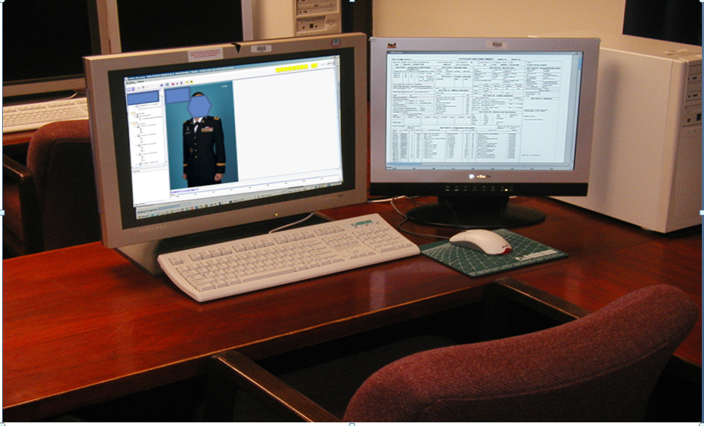
Army Selection Board System
Notes:
Here is the dual monitor ASBS file review system that board members use.
Note the ORB is Visible on the right, Your Photo is immediately up front, and on the left are all of you OERS, Awards and Disciplinary data

Slide 79
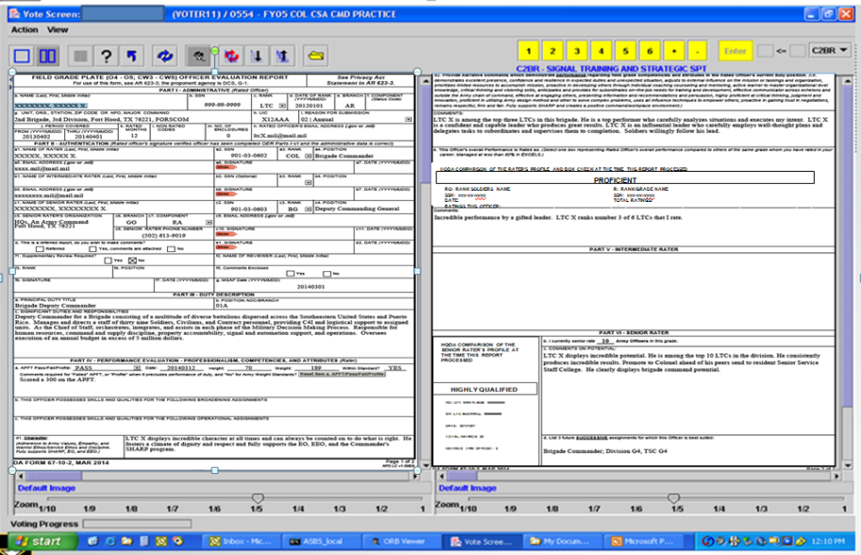
Board Screenshot
Notes:
Evaluations screenshot

Slide 80
What do boards focus on?
3 Parts to a Board file
DA Photo
ORB
OMPF (OERs, Disciplinary Data, Awards, AER)
Quantified and Qualified, Descriptive Strong vs. Exclusive
1. Senior Rater Section:
- Narrative
- DA Label Information (if applicable)
- Population Size
2. Duty Description
3. Number of Rated Months
Rater Narrative
- Narrative
- DA Label Information (if applicable)
- Population Size
5. Intermediate Rater Narrative (if used)
Notes:
Board members typically look at the Senior Rater narrative and read the comments on performance, potential and recommended schooling or future positions. In post board surveys, board members list the senior rater section (specifically the narrative) as the single most important element in helping them determine how to vote a file. Next is the senior rater label and associated information (if it applicable for the rated officer’s rank). This provides the name of the rated officer, the senior rater’s name, the date of the rating, the total number of ratings this Senior Rater has completed, and the number of times this officer has been senior rated by the same individual, as well as any corresponding Block Check. An additional factor that board members look at when there is a block check is the Senior Rater Population size. This helps them determine if the senior rater has a small population, and might be limited in number of officers in the rating population. Board members next look at the Duty Description in helping to determine the scope of responsibility of the officer and the length of the OER (the number of rated months). Additionally, the number of rated months on an OER helps to determine the weight that it may carry with a board member. Board members understand that there are times when a 3 month OER may be required by regulation, and that the amount of time that the rater and senior rater have had to formulate comments on performance and potential is different than is the rating period is for 12 months. Board members also list the rater’s narrative as that final confirmation in looking at comments on performance, potential, and future schooling and positions.
Most notably, board members are able to determine when a senior rater is attempting to write a strong narrative versus an exclusive narrative. These are typically done through the use of a percentage, or a numeric representation of where the rated officer falls in comparison to those other officers in the senior rater’s rating history. Senior rater narratives should be quantified, qualified descriptive narratives of the senior raters passion, or lack thereof, for the rated officer.

Slide 81
PREPARING FOR YOUR NEXT BOARD
S1 situational awareness (S1 NET)
Read the MILPER
  Eligibility criteria
  ‘My Board File’ dates
  OER cutoff dates / document submission
Validate ‘My Board File’
Clean up ORB
Photo in ASU
Communicate to your Rater/SR career goals
Avoid height/weight inconsistency on records
Performance
Notes:
SHOW SLIDE: PREPARING FOR YOUR NEXT BOARD

Slide 82
RATERS / SENIOR RATERS
Selection boards are the audience for evaluations
Quantify/articulate Officer’s standing, “my number 2 of 15 company commanders”
Avoid cookie-cutter evaluations
Avoid ‘stair-stepping’ box checks
Avoid inconsistencies in box check and narrative
Notes:
SHOW SLIDE: RATERS/SENIORS RATERS

Slide 83
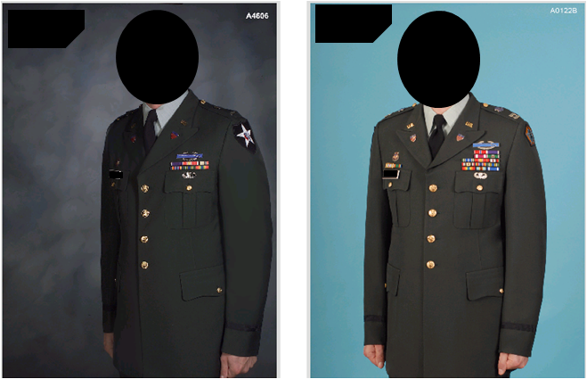
OFFICIAL PHOTOGRAPH
Advise your population on what is/isn’t a good photo
Don’t be “that guy”

Slide 84
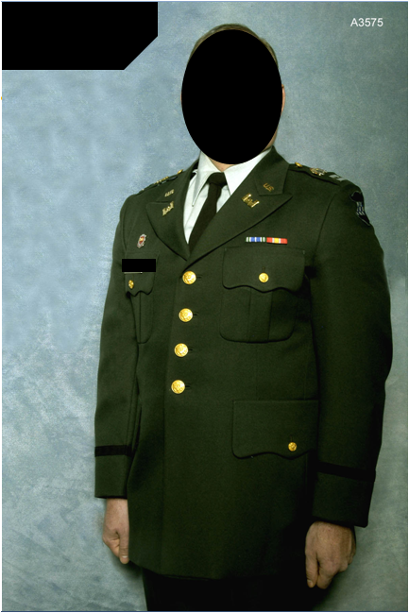

Slide 85
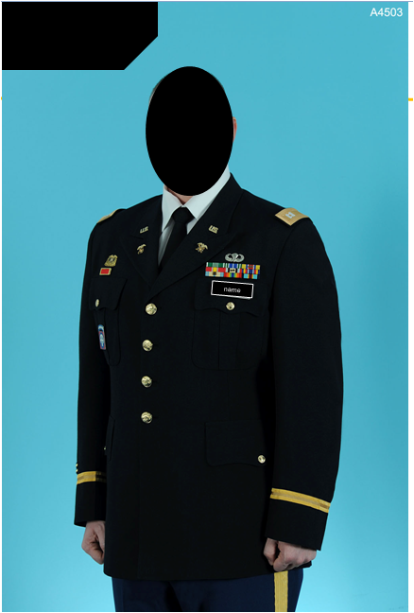

Slide 86
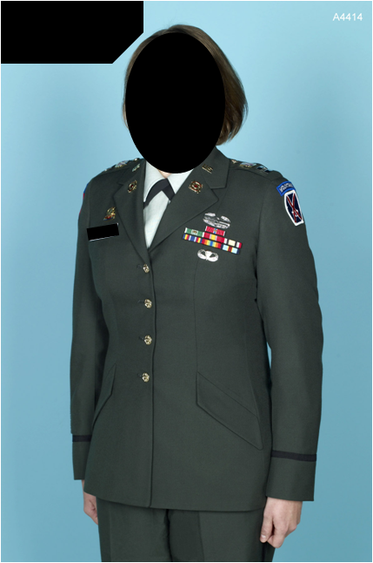

Slide 87
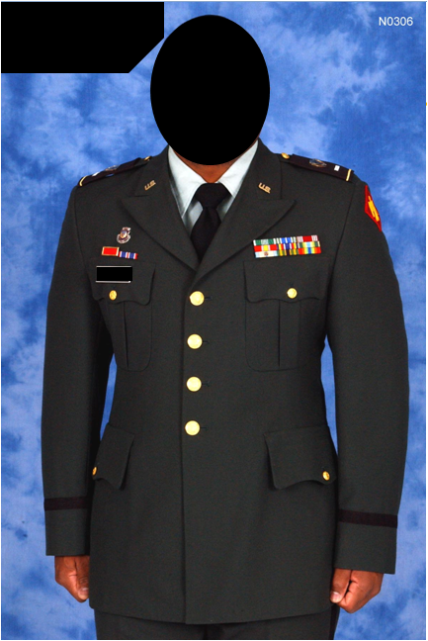

Slide 88
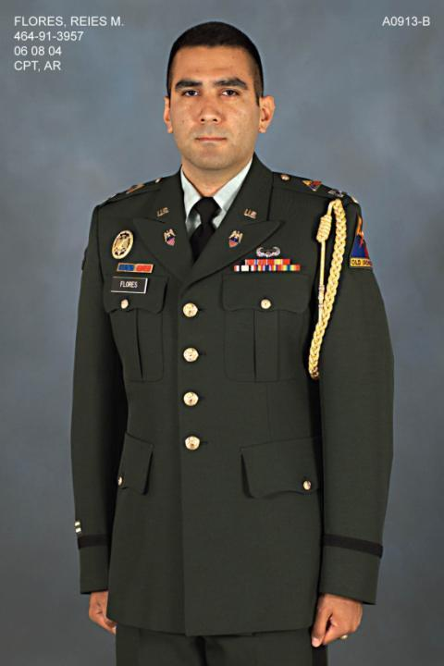

Slide 89
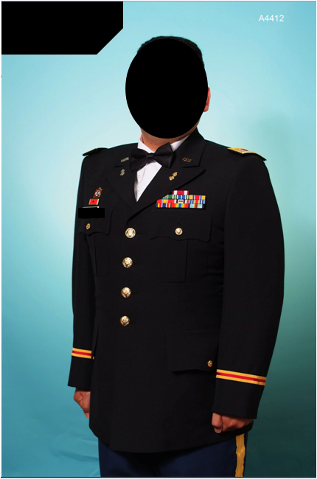

Slide 90
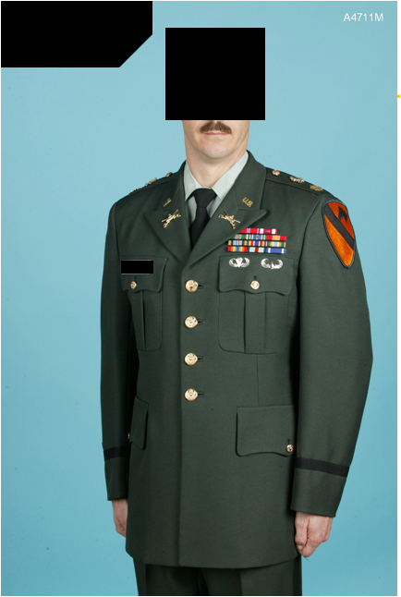

Slide 91
QUESTIONS

Slide 92

Additional
Officer Promotion Information
Provided by HRC Promotions Branch
Fort Knox, Kentucky
https://www.hrc.army.mil/site/active/tagd/MSDSecretariat/OfficerBoards/OfficerBoards.htm

Slide 93


Officer Promotion
Authority and References
Laws
Title X: United States Code - Armed Forces
DoD Instructions
DOD Instruction 1320.4 - Military Officer Actions Requiring Approval of the Secretary of Defense or the President, or Confirmation by the Senate
  DOD Instruction 1320.12 - Commissioned Officer Promotion Program
  DOD Instruction 1320.14 - Commissioned Officer Promotion Program Procedures
  Department of the Army Memorandum
  DA Memo 600-2 - Policies and Procedures for Active Duty List Officer Selection Boards
Army Regulations / DA Pamphlets
AR 600-8-29 - Officer Promotions
DA PAM 600-3 - Commissioned Officer Professional Development and Career Management
Notes:
SHOW SLIDE: AUTHORITY AND REFERENCES
The legal basis for commissioned officer promotions is contained in Title 10, United States Code (USC). This law prescribes:
Strength and grade authorizations
Promotion list components
Promotion procedures
Separation procedures resulting from non-selection
The statutory requirements of Title 10 USC are carried out through DOD Directives, Army Regulations, and policy developed by the Army G-1 to administer the officer promotion system. While as an S-1 it is unlikely you will ever need to refer to anything but an Army Regulation, as an HR Subject Matter Expert, principal HR advisor to your commander, and HR professional, these references will provide you with the “big picture” on officer promotions. I encourage you to review the hyperlinks when you have an opportunity.

Slide 94
Frequently Asked Questions
(FAQs)
How much time does a board spend reviewing my file?
Depending on the size of the board (total population) and your zone of consideration, each board member typically spends one to five minutes per file. In and Above the zone files are generally reviewed for approximately two to three minutes. Below the Zone files are first reviewed during a screen vote for approximately one to two minutes. The board will then conduct a second vote of higher quality files that possess solid potential for BZ selection. During the second BZ vote, boards typically review each file for approximately two to three minutes.
What input does Branch have in the selection process?
NONE. 30 days prior to the board’s convene date assignment officers review the actual board files for two weeks to ensure accuracy. Once their review is complete, the DA Secretariat Board Recorders conduct a final check for completeness prior to voting. Officer management branches DO NOT provide OMLs of their “top” people to the board. Files are distributed to board members randomly.
Notes:
SHOW SLIDE: FREQUENTLY ASKED QUESTIONS (FAQs)

Slide 95
Frequently Asked Questions
(FAQs)
What OER / Administrative information is briefed to the board?
DODI 1320.14 allows administrative information to be briefed to the board. The board receives an information briefing on the two types of OER’s, the 67-8 and the 67-9. Part IV “Professionalism” block check is explained, how to identify small populations, small Senior Rater Profiles, and numerous examples of different types of Rater and Senior Rater comments.
What are the most important things to do prior to my next board?
Ensure that your OMPF, photo and ORB are up to date.
Are there racial, ethnic or gender requirements?
There are NO race, ethnic or gender requirements. Officers are promoted based on merit and branch/skill requirements. The military monitors the selection and promotion rates of all personnel.
Notes:
SHOW SLIDE: FREQUENTLY ASKED QUESTIONS (FAQs)

Slide 96
Frequently Asked Questions
(FAQs)
Are letters to the Board President (LTBP) needed/recommended?
Officers eligible for consideration may write to the board to provide documents and information calling attention to any matter concerning themselves that they consider important to their consideration. They are not required.
Prudence should be used when deciding whether or not to write a letter to the board president. If there is something in your file that you feel needs an explanation, write a letter that clarifies the issue. Keep it brief and to the point. Keep in mind that a letter will only draw attention to the issue you are explaining. Use your best judgment.
What OER’s are masked if any?
For commissioned officers Year Groups (YGs) 1984 and earlier - no OER’s are masked; YGs 1985 and 1986 - 2LT OER’s are masked; and YG 1987 and later - all LT’s OER’s are masked. Warrant officer WO1 OERs are masked upon their promotion to CW3.
Notes:
SHOW SLIDE: FREQUENTLY ASKED QUESTIONS (FAQs)

Slide 97
Terminal Learning Objective
Action: Administer Officer Promotions and Selections
Conditions: Given classroom instruction, AR 350-100 (Officer Active Duty Service Obligations), AR 600-8-29 (Officer Promotions) and awareness of Operational Environment (OE), variables and actors.
Standard: Score 70% or higher on a knowledge based exam that includes the following learning activities:
Define the objectives of the AC officer promotion system.
Communicate decentralized and centralized officer promotion system policies and procedures.
Review DA Selection Board process
Notes:
SHOW SLIDE: TERMINAL LEARNING OBJECTIVE

